Slide 1


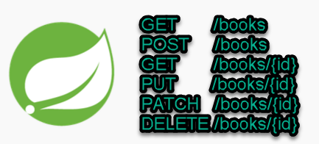
Spring boot REST Example for Path Variable Validation
Postman client
SpringBootDemo
DB
Consuming a RESTful Web Services by using Postman client
REST Endpoints to Create/Update/
Get/Delete book details

Slide 2

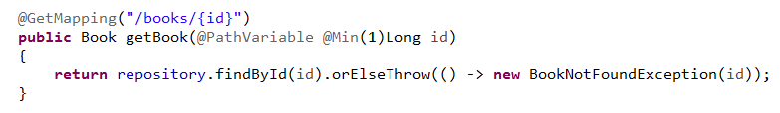
Spring boot REST Example for Path Variable Validation
Apply @Validated on class level, and add the javax.validation.constraints.* annotations on path variables
1

Slide 3
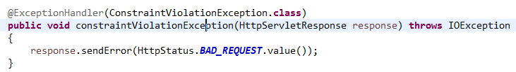
Spring boot REST Example for Path Variable Validation
2
If the @Validated is failed, it will trigger a ConstraintViolationException, we can override the error code like this

